Slide 1
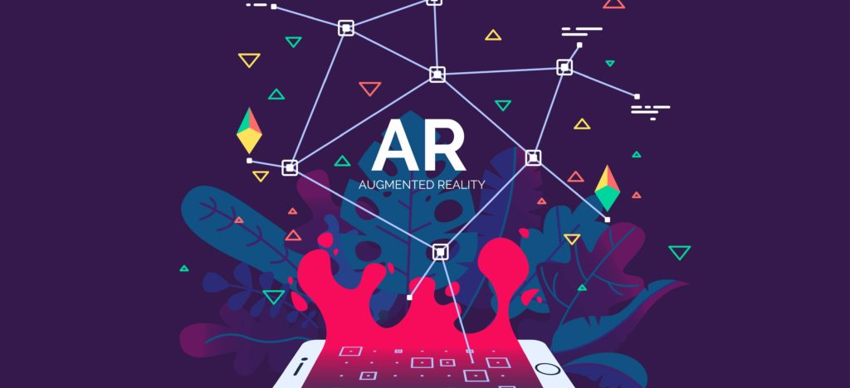
“WHEN I THINK ABOUT BIG THINGS, I THINK ABOUT AR ”
TIM COOK

Slide 2

AUGMENTED REALITY AS A NOVEL WAY OF SHOPPING

Slide 3
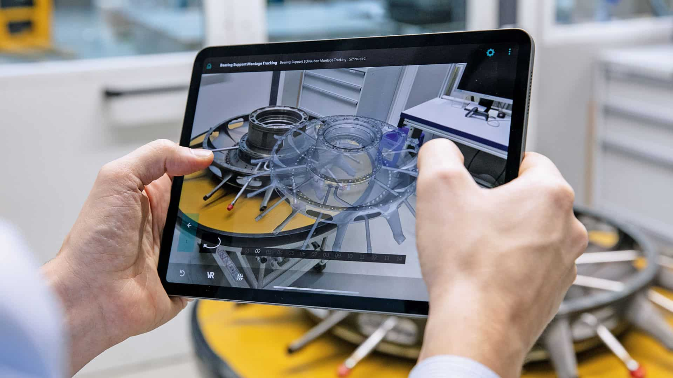
What is Augmented Reality?
Augmented reality (AR) is an interactive experience of a real-world environment where the objects can be enhanced by computer-generated perception in order to be manipulated by users will.

Slide 4
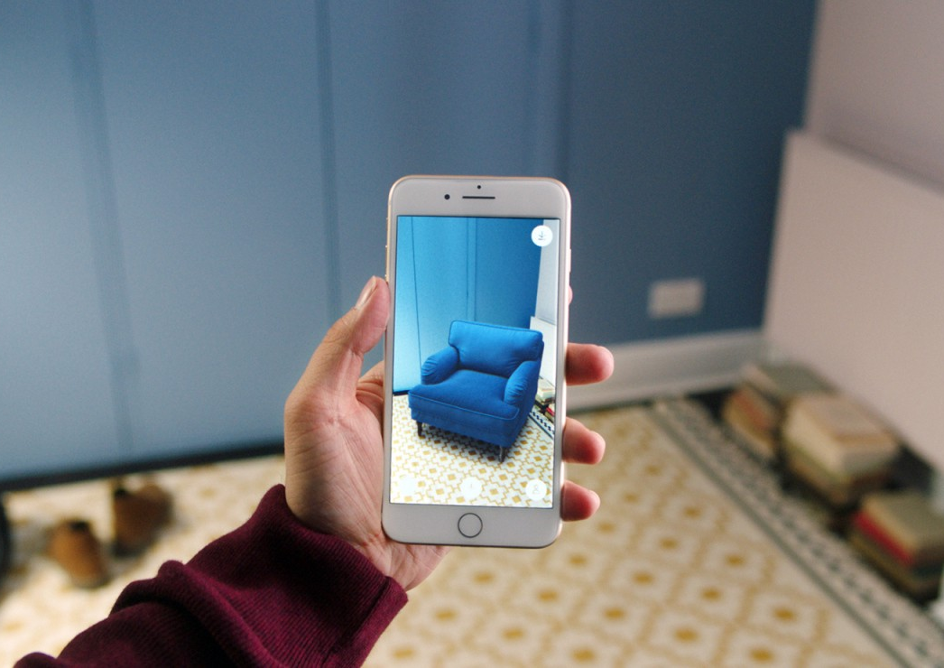
Augmented Reality for Shopping and Ecommerce
Innovation trends nowadays influence significantly the brand’s marketing strategy.
Following the trend, Augmented Reality has emerged as an innovative tool allowing brands to interact with consumers on their mobile devices.
AR creates a new digital experience enriching relationship between consumer and brand which can be used anywhere.

Slide 5
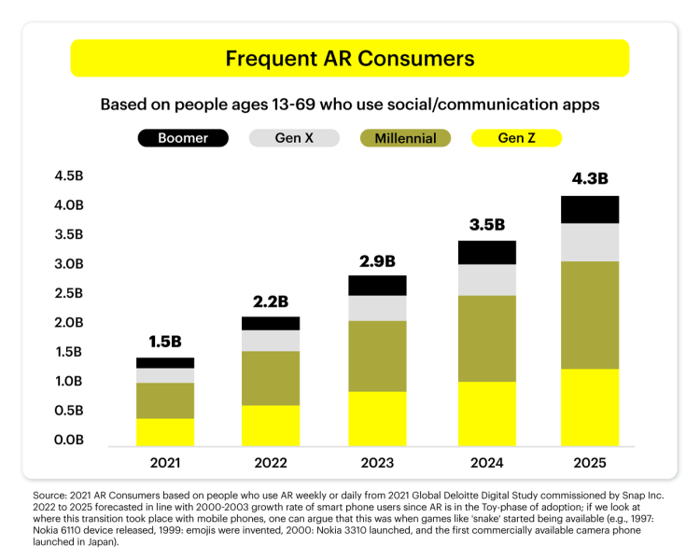
Popularity of AR

Slide 6

STATS AND TRENDS
According to Statistics,
$30.7 billion
810 million
400,000
Market Value
Active Mobile Users
AR glasses sold

Slide 7
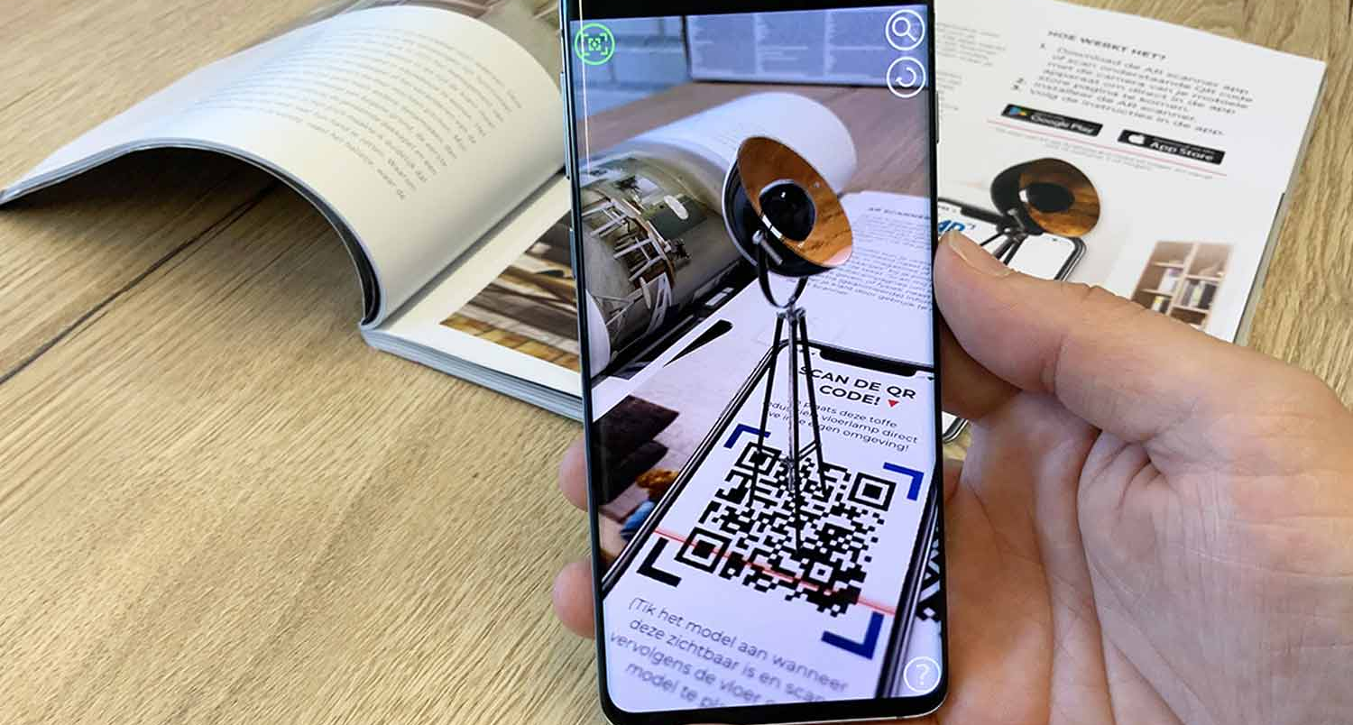
Why Choose AR?
Augmented Reality comes up with a lots of Perks:
AR can provide crucial product and inventory management information at a glance.
Checking products and stock information can be a significant pain point for retail employees
This can be resolved by the smart scanning app with AR which reveals information with AR overlay.

Slide 8
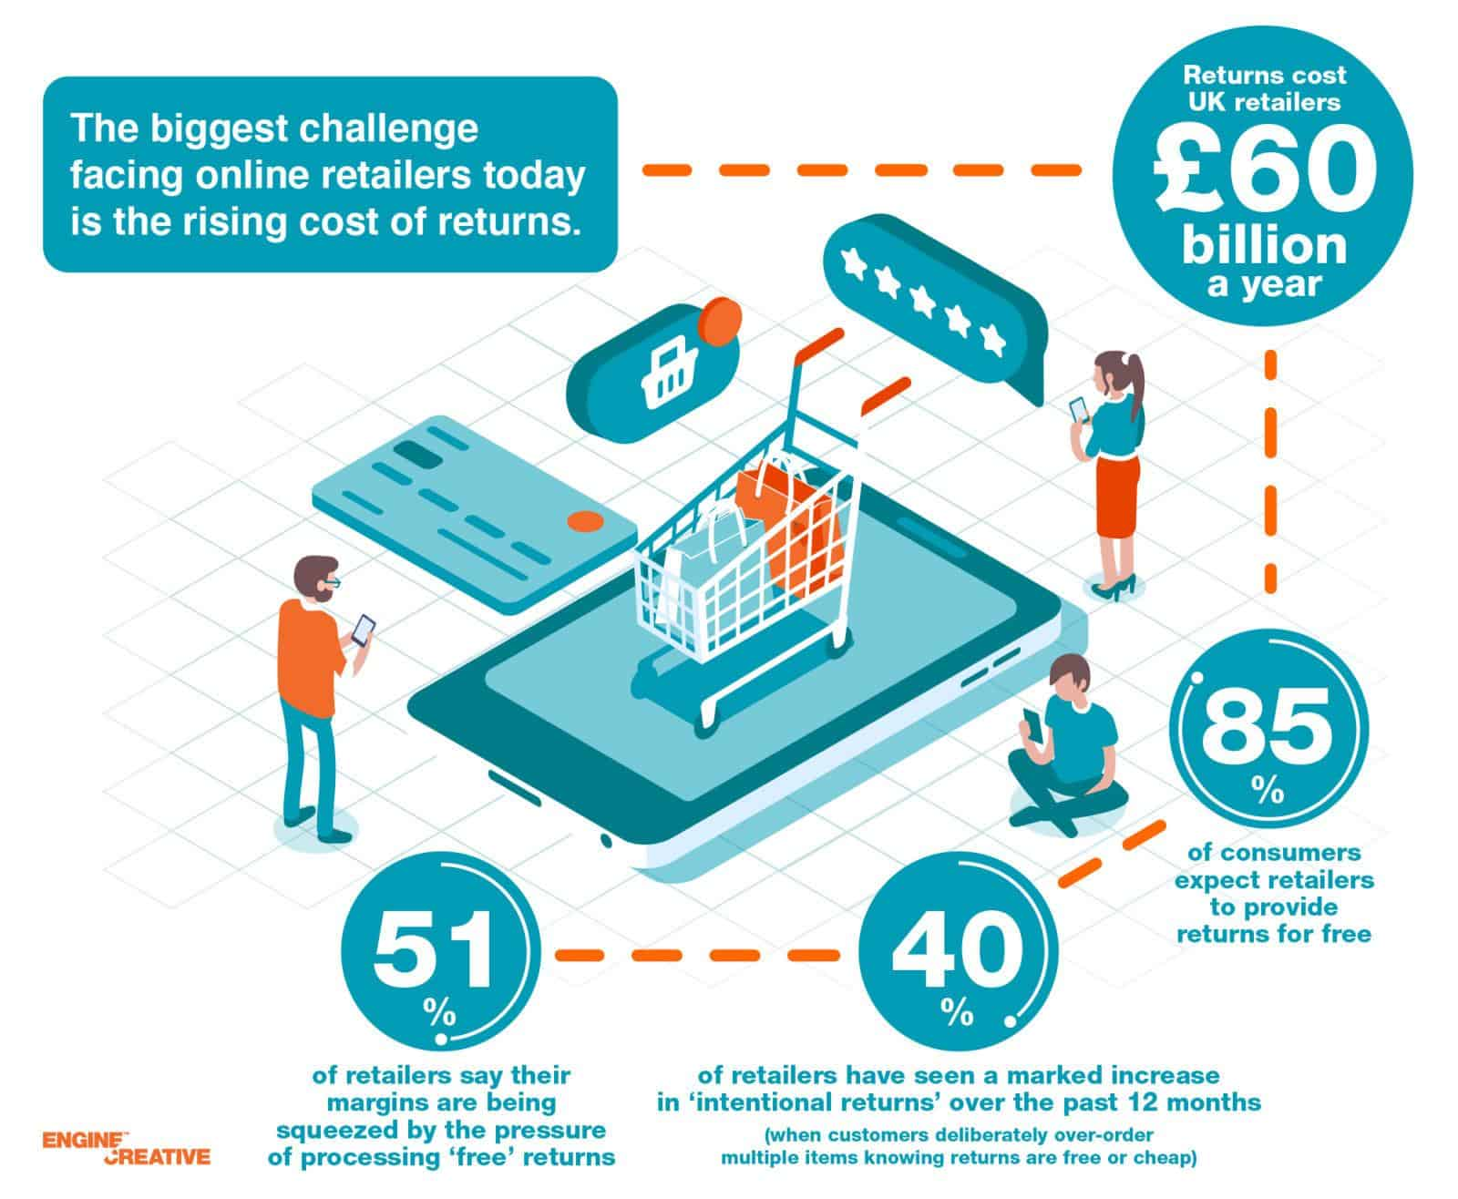

Slide 9
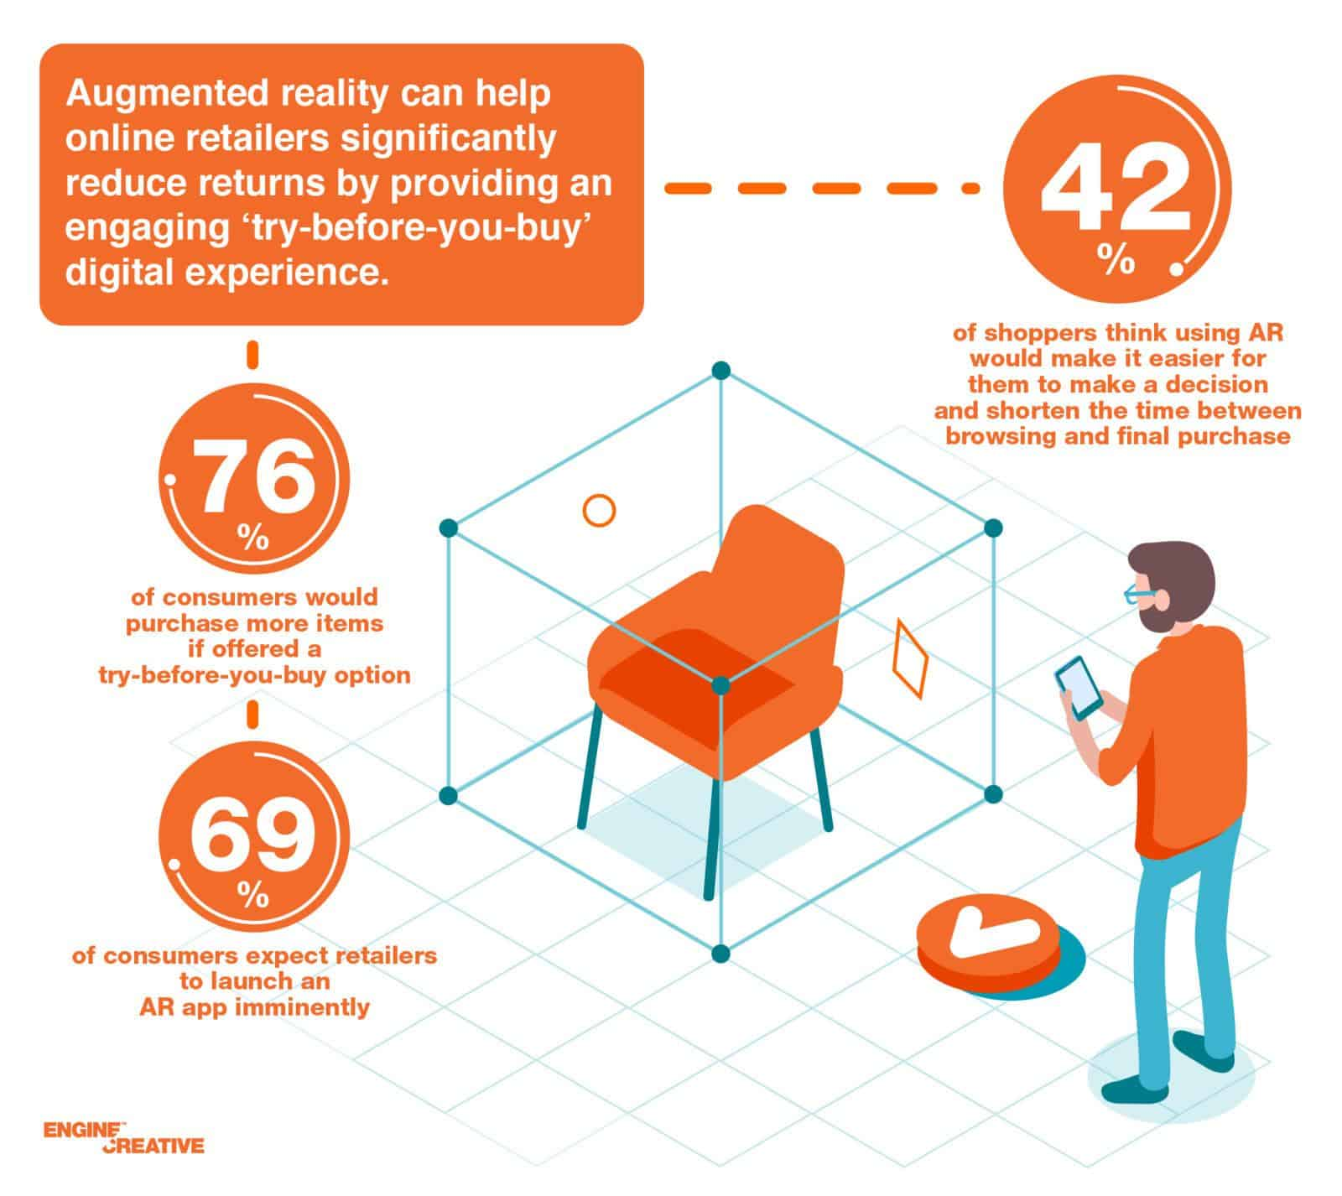

Slide 10
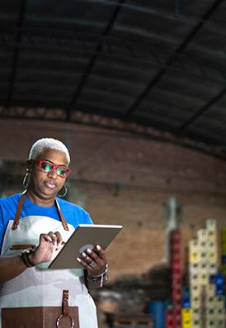
Augmented Reality: A Gate Way to Retail Innovation
Augmented Reality is paving the path for the better in a number of ways especially after arrival of Covid-19 Pandemic.
The preference of people has shifted to shopping online. According to a Survey, more than half of US Americans have shifted to online shopping.

Slide 11
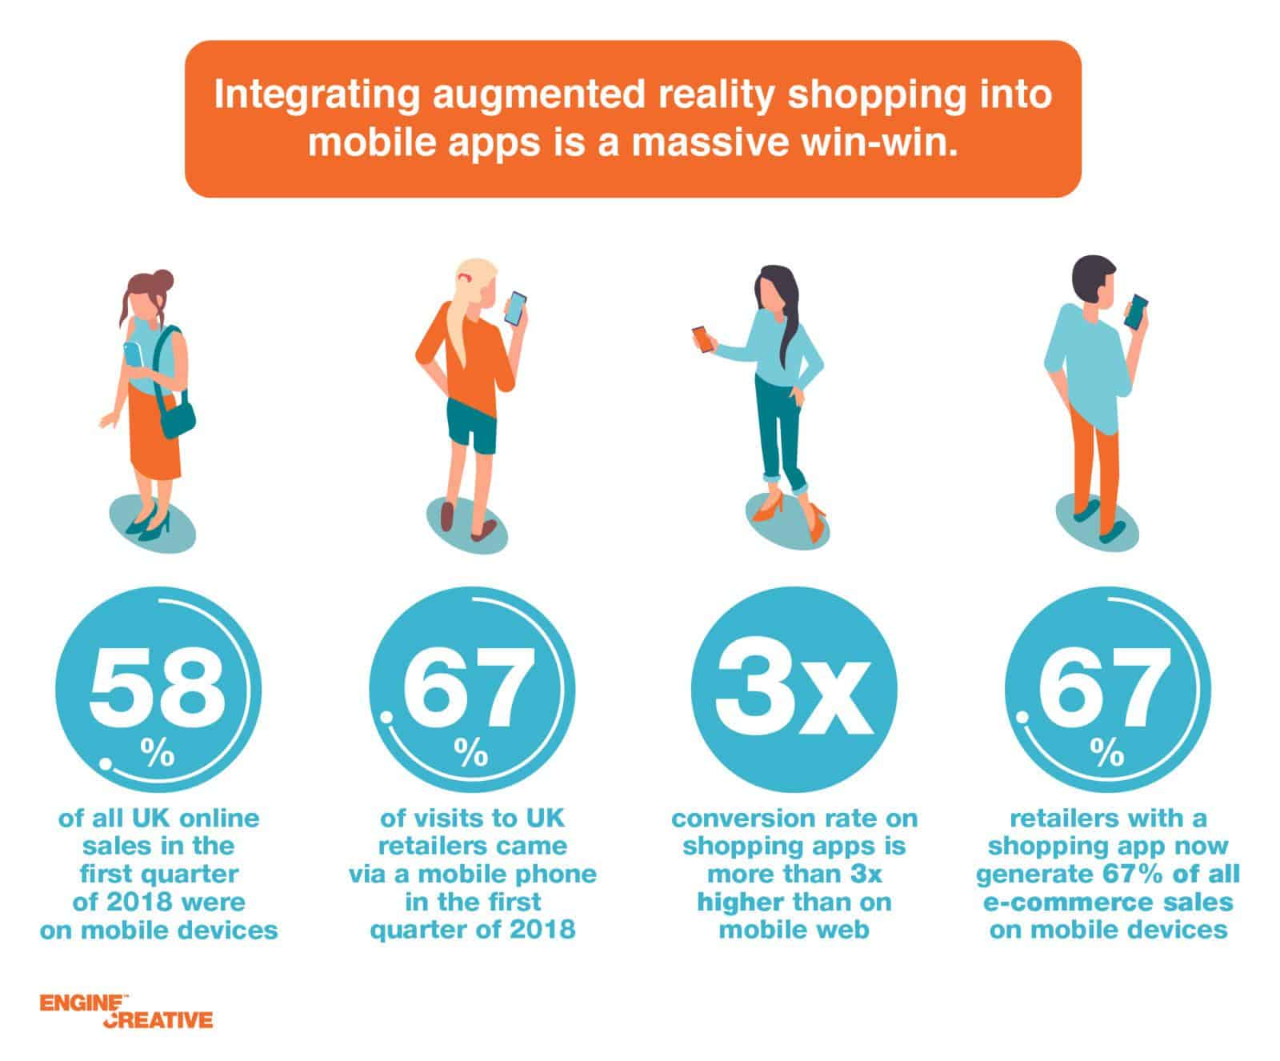
INTRODUCE AR TO YOUR RETAIL BUSINESS
Augmented is a big overhaul for media consumption as well as for how we buy new stuff. Not only will it make your business for interactive, costumers will be more willing to buy your product.
Many businesses have integrated AR and so should you.

Slide 12
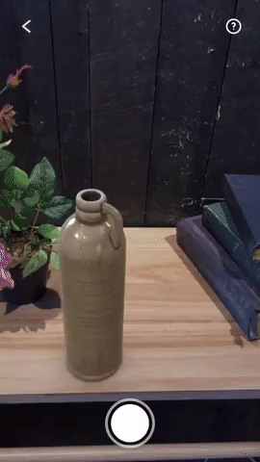
Engaging Customer Experiences
Customers have a chance to view and interact with products they same way they could visiting a store
AR Experts call the next phase of AR as “gamified social experience.”

Slide 13
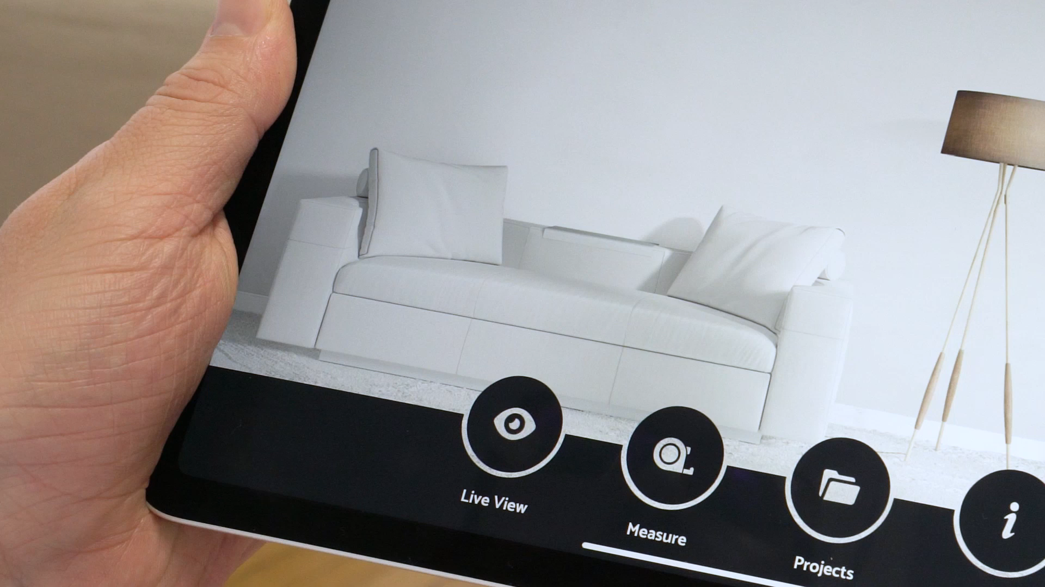
Demonstration of AR Furniture

Slide 14

Increase Customer Confidence and Lower Return Rates
According to study by UPS, 27% of consumers return the bought products claiming them “Not as described.” AI gives the option of “Try before you buy,” giving consumers more information to decide with reducing return rates.

Slide 15
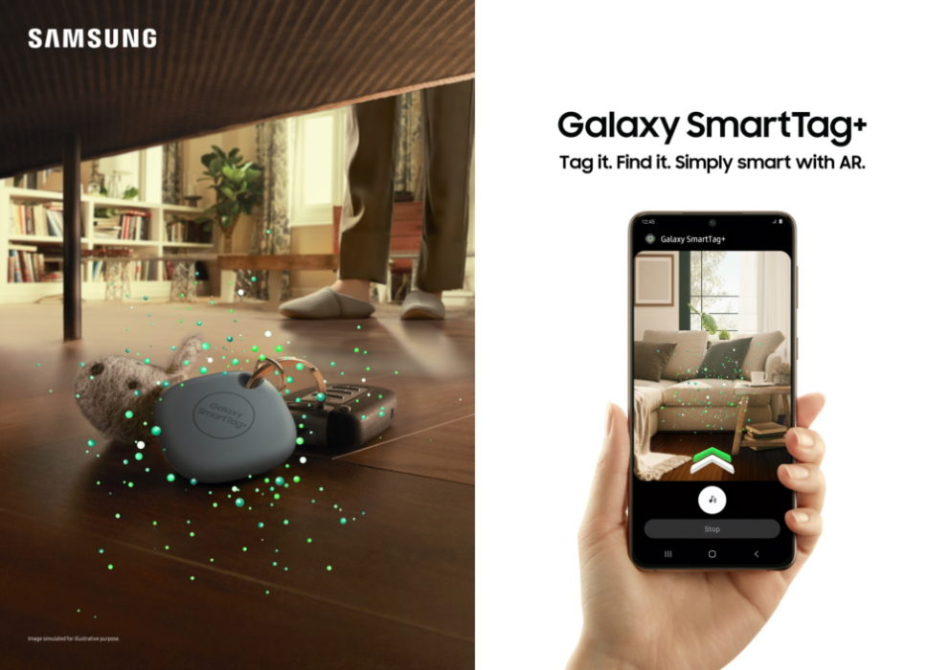
Price verification and Item Location
Retail employees can use smart devices with AR to efficiently correct price errors and rearrange incorrectly placed products.
Store Staff can quickly compare product data with actual price labels.

Slide 16

Virtual-store order picking
Retail staff can use AR technology to quickly and seamlessly find the correct products for shoppers with a single touch on their smartphones.
This enables pickers to find the right customer items much more rapidly from a crowded assortment of products.

Slide 17
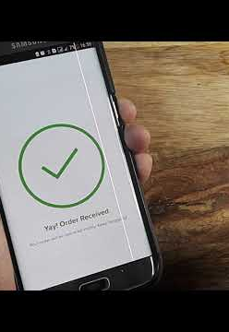
Shipping & Receiving
Using smartphones enabled with AR software, warehouse staff can instantly identify and collect orders through one comprehensive app.
This provides for a more efficient shipping and receiving effort.

Slide 18

Personalization of User Content with AR
Retailers often customize content to meet the best expectations of the customer.
VR or Virtual Reality is also rendered for enhancement. Together, they provide comprehensive AR VR retail solutions.

Slide 19
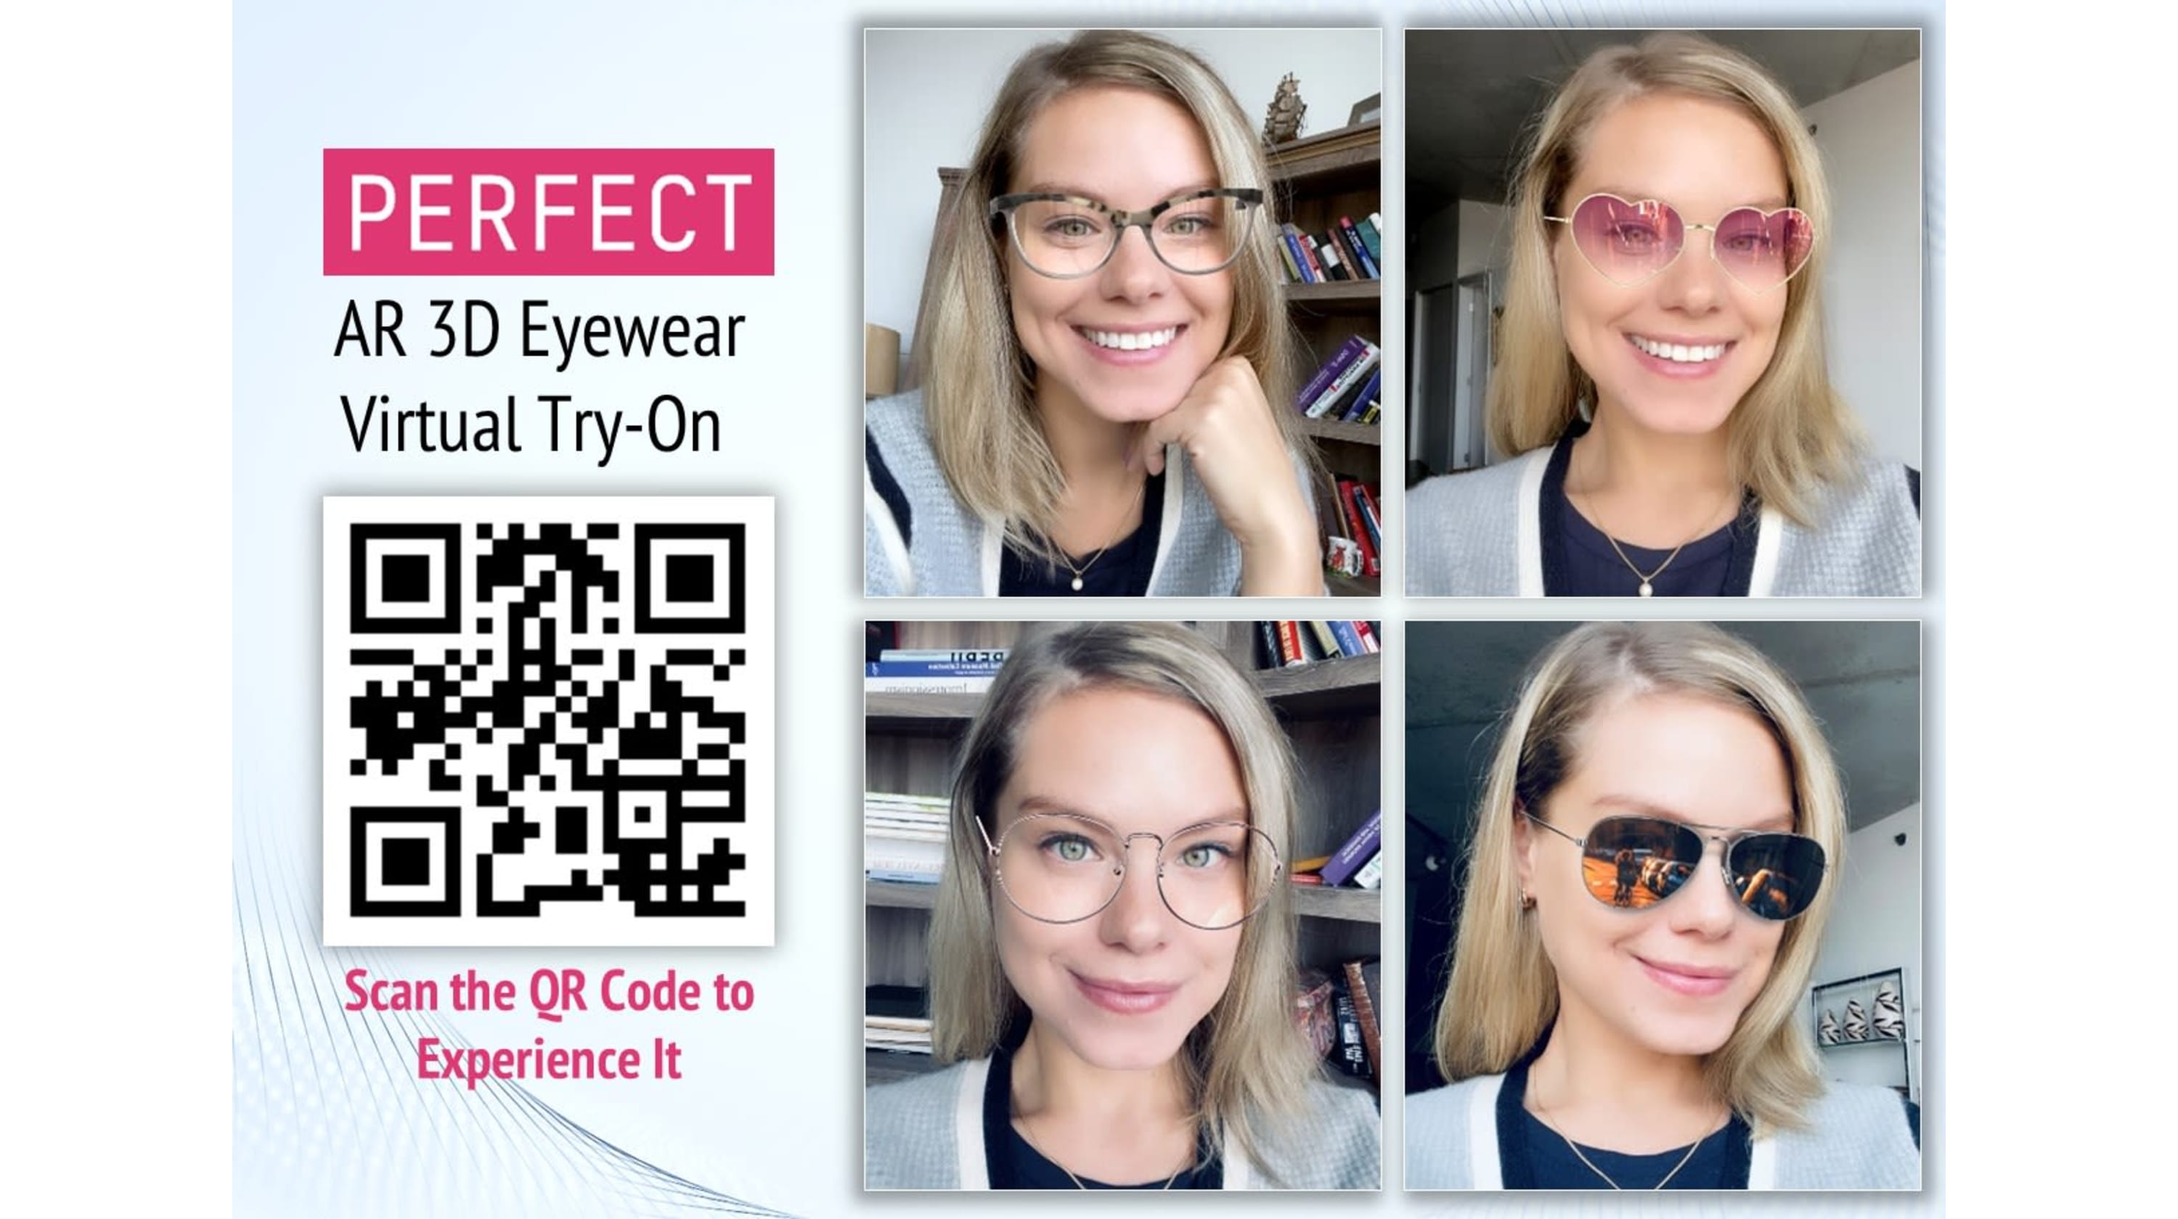
Ease of Trials/Tryouts
AR can make things a lot easier by having to check stuff without having to actually try it.
there are virtual mirrors where you can simply find out the size of the dresses you like.
In a digital screen in front of you, you can see how that apparel is looking and fitting your body.

Slide 20
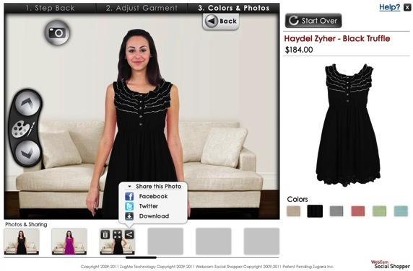
Diversity of Shopping
Augmented Reality combines traditional retailing with online shopping by combining all the retailing stores worldwide.
AR adds a new touch to shopping style my giving a friendlier interface for the buyer.

Slide 21
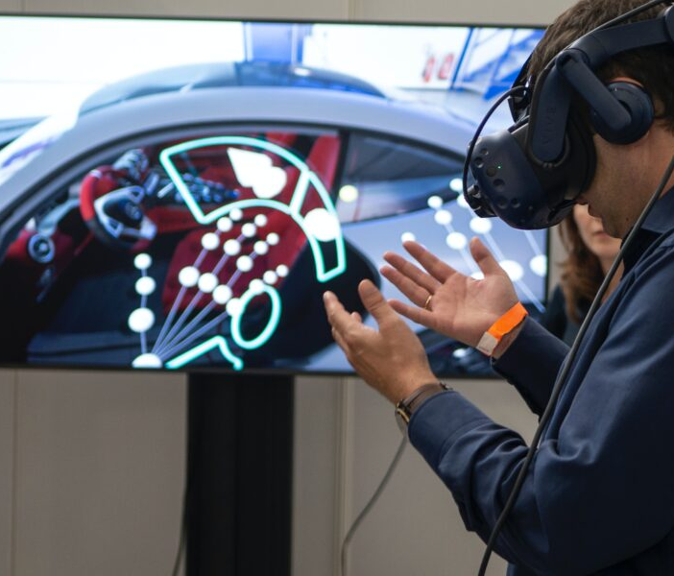
Reduces Hygienic Issues
With the outbreak of Covid-19, shopping has taken an another level by adapting to the online shopping experience with the help of AR.
People can now buy stuff without having to get involved in gatherings and in this way, shopping can be done without making any physical contact!

Slide 22

A Time Saving System
Augmented Reality stores can significantly reduce the amount of time it takes for a person to shop without having to wait in a line or while travelling.
Customers can actually get what they want by adopting this seamless way of shopping!

Slide 23
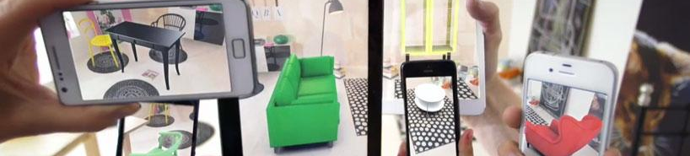
Augmented Reality for Furniture Stores.
The future of furniture shopping.

Slide 24





Popular Furniture Apps Using AR

Slide 25
GROCERY SHOPPING WITH AUGMENTED REALITY

Slide 26
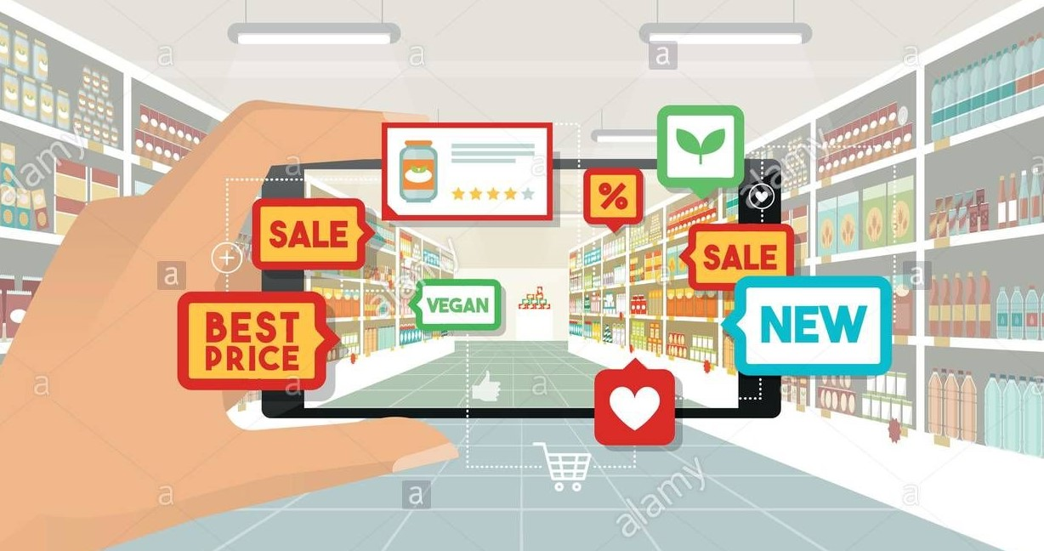
Navigating through a large or unfamiliar family to find to find all the items on your list isn’t any fun. Wouldn’t it be great to have a shopping route which guide you to your items? What if you could learn more about an item simply by looking at it?

Slide 27


Luckily Alex uses the fresh land market app on her smartphone.

Slide 28
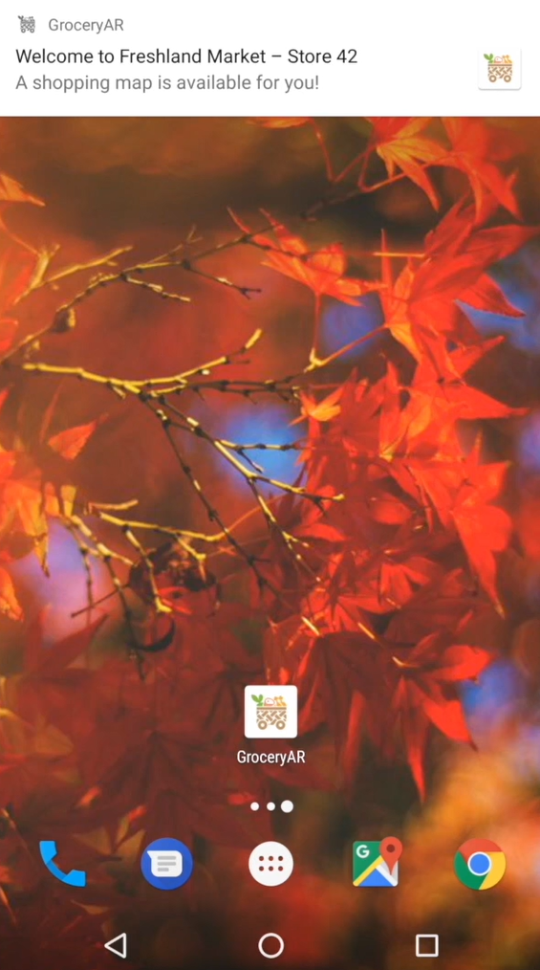
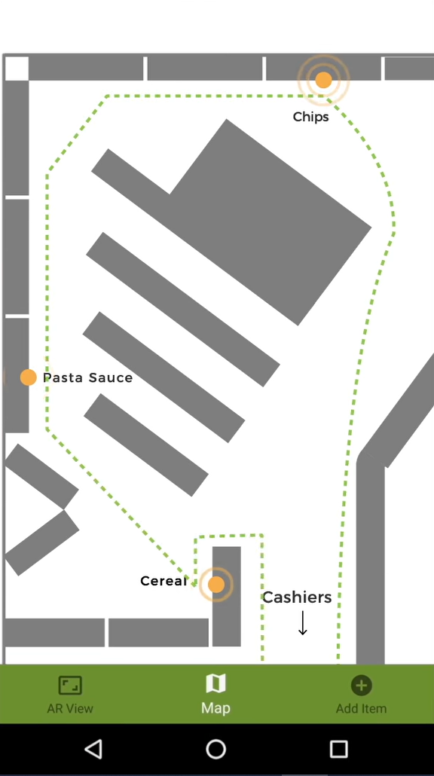
White
As Alex walks up to fresh land market, the app pops up a notification. She taps it and a map of the store appears showing where all of the items on her list are located.
White

Slide 29
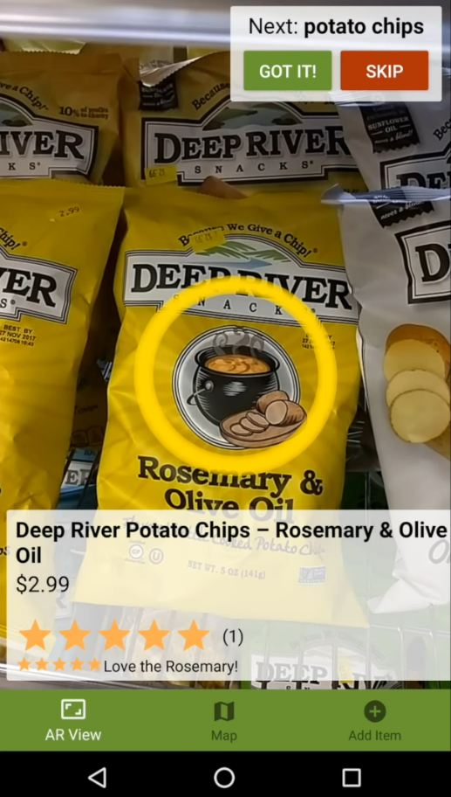
ITEM#1: Potato Chips With map as a guide, Alex walks over and grabs a bag of potato chips. When she looks at it with her smartphone, the app recognizes it and displays useful information like it's price and user ratings. Alex checks the potato chips off her list in the app.

Slide 30
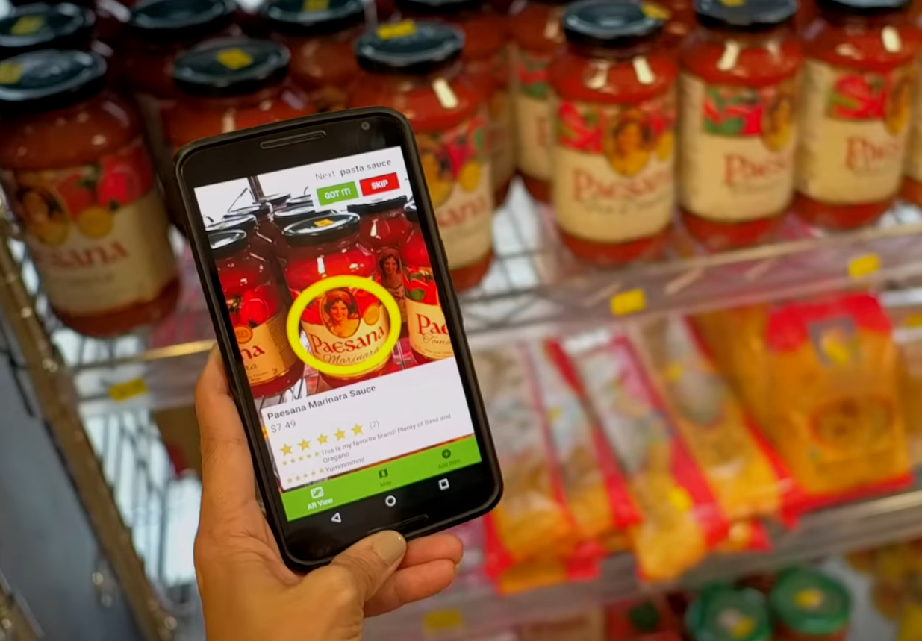
ITEM#2: Pasta Sause
Next is pasta sauce. Unfortunately, she's not sure which one she wants. With the help of the user reviews and ratings the app superimposes on top of the camera view. She can make an informed decision.

Slide 31

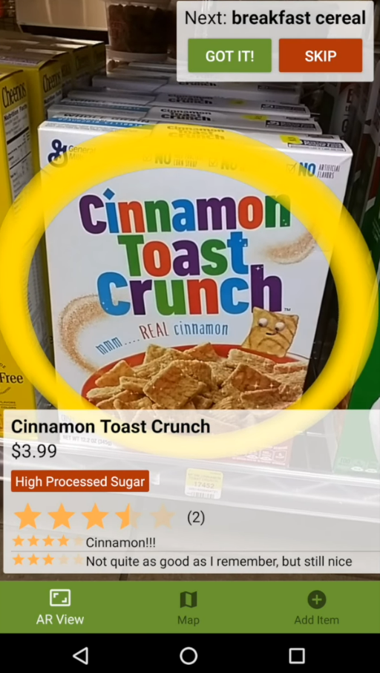

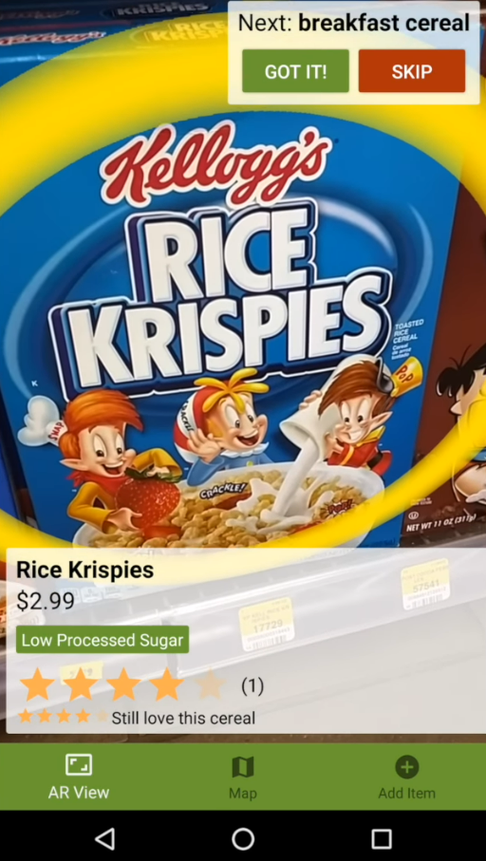
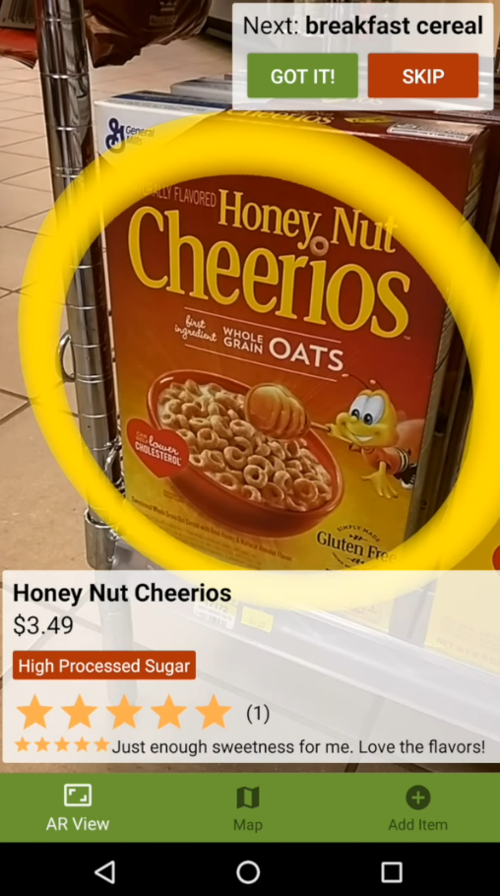

Last one is cereal. Alex recently chose to avoid processed sugars and already configured the app to tell her if anything contains them.
The app tells her that her favourite Cinnaamon Toast Crunch is not a good fit.
Honey nut also have processed sugars.
Finally Alex checks a box of Rice Krispies cereal and bingo! Low processed sugars.

Slide 32
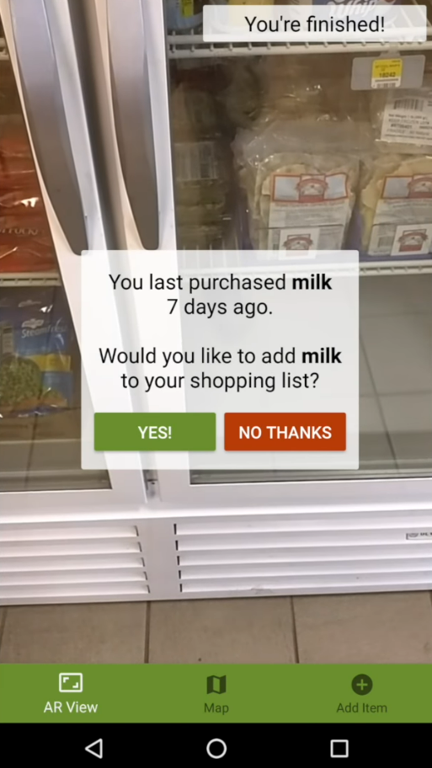
White
Suddenly Alex sees a new notification suggesting that it might be time to buy milk to go with her cereal based on her purchase history. The app updates the shopping route and redirects her to the dairy section.
white

Slide 33

SHOPPING IS FINISHED!

Slide 34
THANK YOU!

